Slide 1

CSE101 Intro to CS and Programming
Quiz 1 Solution
Lecture 8 (Week 4)
By Mr. Faheem Shaukat
faheem@iqraisb.edu.pk
www.tinyurl.com/IUICLectures

Slide 2
Q. No. 1 Write any five characteristics of Computer? (5 Marks)
Quiz 1 Subjective Solution
Automatic:
Speed:
Accuracy:
Power of Remembering:
No Feelings:
Q. No. 2 Difference between Data Processor and Data Processing? (4 Marks)
A computer is also called a data processor because it can store, process, and retrieve data whenever desired.
The activity of processing data using a computer is called data processing.

Slide 3
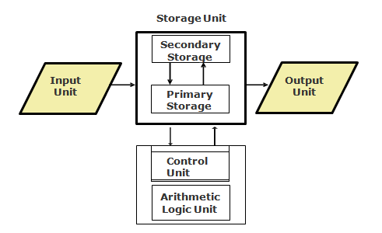
Q. No. 2 Draw block diagram of Computer Organization Units? (4 Marks)
Q. No. 1 Write five basic operations perform by computer? (5 Marks)
Inputting
Storing.
Processing.
Outputting.
Controlling.

Slide 4
Q. No. 4 Define following in 2 Lines? (2 Marks each=8 Marks)
Accumulator Register
Holds data to be operated upon, intermediate results, and the results
Memory Buffer Register
Holds contents of the accessed (read/written) memory word
EEPROM
A type of EPROM chip in which the stored information is erased by using high voltage electric pulses
UVEPROM
A type of EPROM chip in which the stored information is erased by exposing the chip for some time to ultra-violet light
Firmware
Firmware is software substituted for hardware and stored in read-only memory
Middleware
Act as “glue” between client and server parts of application

Slide 5
Q. No. 5 Difference between Application software and System Software? (4 Marks)
System software is designed to control the operation and extend the processing capability of a computer system
Application software is designed to solve a specific problem or to do a specific task

